Slide 1
CSCI 5822 Probabilistic Models of Human and Machine Learning
Mike Mozer
Department of Computer Science and Institute of Cognitive Science University of Colorado at Boulder

Slide 2
Today’s Plan
Hand back Assignment 1
More fun stuff from motion perception model
More fun stuff from concept learning model
Generalizing Bayesian inference of coin flips to die rolls
Assignment 3
Bayes networks

Slide 3
Assignment 1 notes
Mean 93, std deviation 11
17 assignments which were difficult to follow
Unfortunate color choices
Printing in grayscale yet using colors for contours
Unreadable plots (contour labels or color)
Didn’t submit code when there was an issue
Task 5: no explanation given
Task 6 (extra credit): kept points separate

Slide 4

Courtesy of Aditya

Slide 5
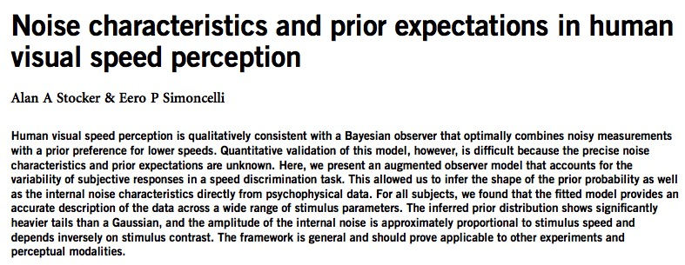
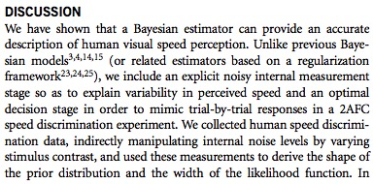

Slide 6
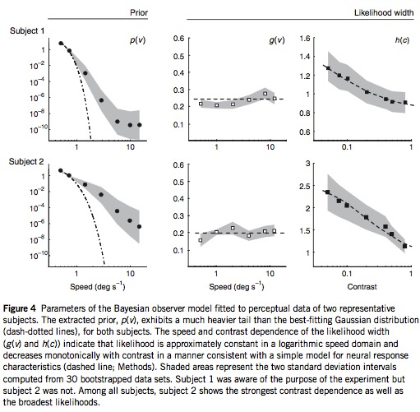

Slide 7
Assignment 1: Noisy Observations
Z: true feature vector
X: noisy observation
X ~ Normal(z, s²)
We need to compute P(X|H)
Φ: cumulative distribution fn of Gaussian

Slide 8
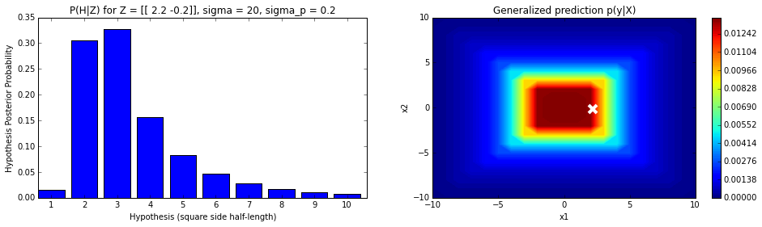
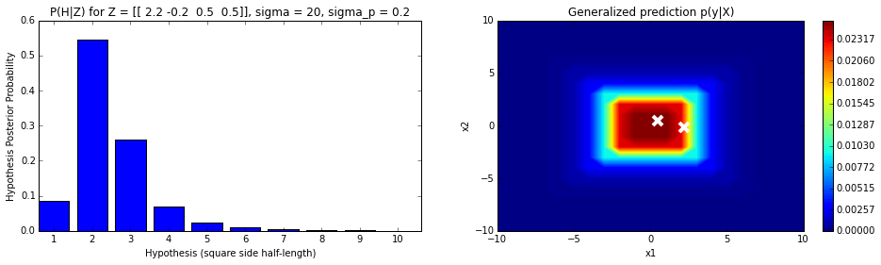
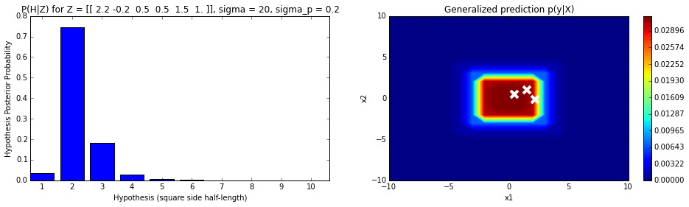
Assignment 1: Noisy Observations

Slide 9
Generalizing Beta-Binomial (Coin Flip) Example to Dirichlet-Multinomial

Slide 10
Guidance on Assignment 3

Slide 11
Guidance: Assignment 3 Part 1

Slide 12
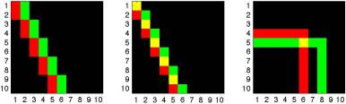
Guidance: Assignment 3 Part 2
Implement a version of Weiss motion model for a set of discrete binary pixels and discrete velocities.
Compare maximum likelihood to maximum a posteriori solutions by including the slow-motion prior.
The Weiss model showed that priors play an important role when
observations are noisy
observations don’t provide strong constraints
there aren’t many observations.

Slide 13
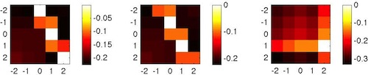
Guidance: Assignment 3 Part 2
Implement a version of Weiss motion model for binary-pixel images and discrete velocities.

Slide 14
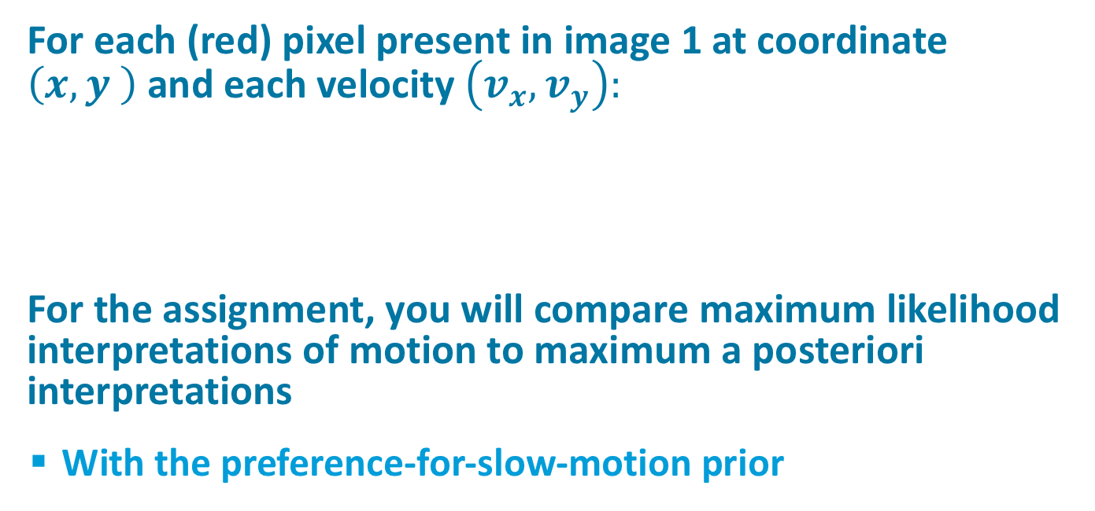

Guidance: Assignment 3 Part 2
For each (red) pixel present in image 1 at coordinate $\left(x,y \right)$and each velocity$\left(v_{x},v_{y}\right):$
For the assignment, you will compare maximum likelihood interpretations of motion to maximum a posteriori interpretations
With the preference-for-slow-motion prior
$$p\left(I_{1},I_{2} | v\right)\sim exp\left(−\frac{{\left(I_{1}\left(x,y\right)−I_{2}(x+v_{x},y+v_{y}\right)}^{2}}{2σ^{2}}\right)$$

Slide 15
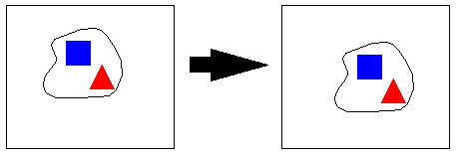
Guidance: Assignment 3 Part 3
Implement model a bit like Weiss et al. (2002)
Goal: infer motion (velocity) of a rigid shape from observations at two instances in time.
Assume distinctive features that make it easy to identify the location of the feature at successive times.

Slide 16
Assignment 3 Guidance
Bx: the x displacement of the blue square (= delta x in one unit of time)
By: the y displacement of the blue square
Rx: the x displacement of the red square
Ry: the y displacement of the red square
These observations are corrupted by measurement noise.
Gaussian, mean zero, std deviation σ
D: direction of motion (up, down, left, right)
Assume only possibilities are one unit of motion in any direction

Slide 17
Assignment 3: Generative Model
Rx conditioned
on D=up is
drawn from a
Gaussian
Same assumptions for Bx, By.

Slide 18
Assignment 3 Math
Conditional independence

Slide 19
Assignment 3 Implementation
Quiz: do we need worry about the Gaussian density function normalization term?

Slide 20
Introduction To Bayes Nets
(Stuff stolen from Kevin Murphy, UBC, and Nir Friedman, HUJI)

Slide 21
What Do You Need To Do Probabilistic Inference In A Given Domain?
Joint probability distribution over all variables in domain

Slide 22
Bayes Nets (a.k.a. Belief Nets)
Compact representation of joint probability distributions via conditional independence
Family of Alarm
Qualitative part
Directed acyclic graph (DAG)
Nodes: random vars.
Edges: direct influence
E
B
P(A | E,B)
Earthquake
Burglary
e
b
0.9
0.1
e
b
0.2
0.8
Radio
Alarm
e
b
0.9
0.1
e
b
0.01
0.99
Call
Together
Define a unique distribution in a factored form
Quantitative part
Set of conditional probability distributions
Figure from N. Friedman

Slide 23
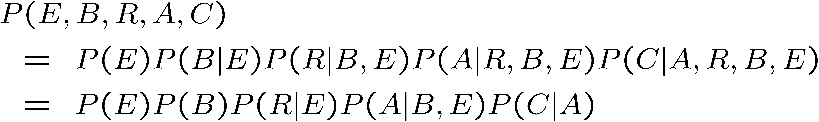
What Is A Bayes Net?
A node is conditionally independent of its
ancestors given its parents.
E.g., C is conditionally independent of R, E, and B given A
Notation: C? R,B,E | A
Earthquake
Burglary
Radio
Alarm
Call
Quiz: What sort of parameter reduction do we get?
From 2⁵ – 1 = 31 parameters to 1+1+2+4+2=10

Slide 24
Conditional Distributions Are Flexible
E.g., Earthquake and Burglary might have independent effects on Alarm
A.k.a. noisy-or
where p_{B} and p_{E} are alarm probability given burglary and earthquake alone
This constraint reduces # free parameters to 8!
Earthquake
Burglary
Alarm
B | E | P(A|B,E)
0 | 0 | 0
0 | 1 | p_{E}
1 | 0 | p_{B}
1 | 1 | p_{E}+p_{B}-p_{E}p_{B}

Slide 25
A Real Bayes Net: Alarm
Domain: Monitoring Intensive-Care Patients
37 variables
509 parameters
…instead of 2³⁷
MINVOLSET
PULMEMBOLUS
INTUBATION
KINKEDTUBE
VENTMACH
DISCONNECT
PAP
SHUNT
VENTLUNG
VENITUBE
PRESS
MINOVL
FIO2
VENTALV
ANAPHYLAXIS
PVSAT
ARTCO2
TPR
SAO2
INSUFFANESTH
EXPCO2
HYPOVOLEMIA
LVFAILURE
CATECHOL
LVEDVOLUME
STROEVOLUME
HISTORY
ERRBLOWOUTPUT
HR
ERRCAUTER
CVP
PCWP
CO
HREKG
HRSAT
HRBP
BP
Figure from N. Friedman

Slide 26

More Real-World Bayes Net Applications
“Microsoft’s competitive advantage lies in its expertise in Bayesian networks” -- Bill Gates, quoted in LA Times, 1996
MS Answer Wizards, (printer) troubleshooters
Medical diagnosis
Speech recognition (HMMs)
Gene sequence/expression analysis
Turbocodes (channel coding)
Notes:
Turbo codes – scheme for efficient (near shannon limit) encoding of information, used in cellular communication. Turbocodes were reinterpreted as a form of (loopy) belief propagation in Bayes nets by Weiss

Slide 27
Why Are Bayes Nets Useful?
Factored representation may have exponentially fewer parameters than full joint
Easier inference (lower time complexity)
Less data required for learning (lower sample complexity)
Graph structure supports
Modular representation of knowledge
Local, distributed algorithms for inference and learning
Intuitive (possibly causal) interpretation
Strong theory about the nature of cognition or the generative process that produces observed data
Can’t represent arbitrary contingencies among variables, so theory can be rejected by data

Slide 28
Reformulating Naïve Bayes As Graphical Model
survive
D
Age
Class
Gender
Rx
Ry
Bx
By
Marginalizing over D
Definition of conditional probability

Slide 29
Review: Bayes Net
Nodes = random variables
Links = expression of joint distribution
Compare to full joint distribution by chain rule
Earthquake
Burglary
Radio
Alarm
Call
Notes:
REVIEW SLIDE when I started lecture here

Slide 30
Quiz
How many terms in the joint distribution of this graph?
What is the joint distribution of this graph?
C
B
A
D
E
F
$$P\left(A,B,C,D,E,F\right)=P\left(C\right)P\left(B\right)P\left(E\right)P\left(A | C\right)P\left(D | B,C\right)P(F|A,D,E)$$

Slide 31
Bayesian Analysis: The Big Picture
Make inferences from data using probability models about quantities we want to predict
E.g., expected age of death given 51 yr old
E.g., latent topics in document
E.g., What direction is the motion?
Set up full probability model that characterizes distribution over all quantities (observed and unobserved)
incorporates prior beliefs
Condition model on observed data to compute posterior distribution
Evaluate fit of model to data
adjust model parameters to achieve better fits

Slide 32
Inference
Computing posterior probabilities
Probability of hidden events given any evidence
Most likely explanation
Scenario that explains evidence
Rational decisions
Maximize expected utility
Value of Information
Effect of intervention
Causal analysis
Explaining away effect
Earthquake
Burglary
Radio
Radio
Alarm
Call
Call
Figure from N. Friedman
Notes:
Rational decisions: need probability estimates of outcomes
value of information: how much would it help to obtain evidence about some variable

Slide 33
Now Some Details…

Slide 34
Conditional Independence
A node is conditionally independent of its ancestors given its parents.
Example?
What about (conditional) independence between variables that aren’t directly connected?
e.g., Earthquake and Burglary?
e.g., Burglary and Radio?
Earthquake
Burglary
Radio
Alarm
Call
Notes:
example? C indep of E and B given A
[equations] we’ve already seen some other examples of independence with the formulation of bayes net

Slide 35
d-separation
Criterion for deciding if nodes are conditionally independent.
A path from node u to node v is d-separated by a node z if the path matches one of these templates:
u
z
v
u
z
v
observed
u
z
v
z
u
z
v
unobserved
z
z
Notes:
D-separation: DEPENDENCE separation. Is information carried along path?
Last case: Z is a collision between U and V.

Slide 36
d-separation
Think about d-separation as breaking a chain.
If any link on a chain is broken, the whole chain is broken
u
u
x
z
z
v
y
v
u
u
x
z
z
v
y
v
u
u
x
z
z
v
y
v
u
u
x
z
z
v
y
v
z
z
Notes:
D-separation: DEPENDENCE separation. Is information carried along path?
Last case: Z is a collision between U and V.

Slide 37
d-separation Along Paths
u
z
v
u
z
v
u
z
v
u
z
v
Are u and v d-separated?
z
u
z
z
v
d separated
u
z
z
v
d separated
u
z
z
v
Not d separated
Notes:
QUIZ: Yes, Yes, and No

Slide 38
Conditional Independence
Nodes u and v are conditionally independent given set Z if all (undirected) paths between u and v are d-separated by Z.
E.g.,
z
u
v
z
z

Slide 39
MINVOLSET
PULMEMBOLUS
INTUBATION
KINKEDTUBE
VENTMACH
DISCONNECT
PAP
SHUNT
VENTLUNG
VENITUBE
PRESS
MINOVL
FIO2
VENTALV
ANAPHYLAXIS
PVSAT
ARTCO2
TPR
SAO2
INSUFFANESTH
EXPCO2
HYPOVOLEMIA
LVFAILURE
CATECHOL
LVEDVOLUME
STROEVOLUME
HISTORY
ERRBLOWOUTPUT
HR
ERRCAUTER
CVP
PCWP
CO
HREKG
HRSAT
HRBP
BP
Notes:
Paths:
shunt-intubation-ventalv
Shunt-sage-pvsat-ventalv

Slide 40
MINVOLSET
PULMEMBOLUS
INTUBATION
KINKEDTUBE
VENTMACH
DISCONNECT
PAP
SHUNT
VENTLUNG
VENITUBE
PRESS
MINOVL
FIO2
VENTALV
ANAPHYLAXIS
PVSAT
ARTCO2
TPR
SAO2
INSUFFANESTH
EXPCO2
HYPOVOLEMIA
LVFAILURE
CATECHOL
LVEDVOLUME
STROEVOLUME
HISTORY
ERRBLOWOUTPUT
HR
ERRCAUTER
CVP
PCWP
CO
HREKG
HRSAT
HRBP
BP

Slide 41
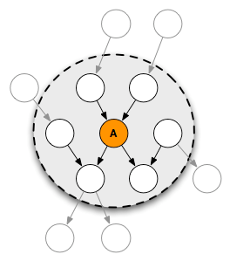
Sufficiency For Conditional Independence: Markov Blanket
The Markov blanket of node u consists of the parents, children, and children’s parents of u
P(u|MB(u),v) = P(u|MB(u))
u
Notes:
W can infer this from the d-separation property – each node outside markov blanket is d-separated from u

Slide 42
Graphical models
Directed
Undirected
(Bayesian belief nets)
(Markov nets, Factor graphs)
Alarm network
State-space models
HMMs
Naïve Bayes classifier
PCA/ ICA
Markov Random Field
Boltzmann machine
Ising model
Max-ent model
Log-linear models
Notes:
BAYESIAN (BELIEF) NET vs. MARKOV NET
Bayesian belief nets are a subset of Markov nets
Any Bayesian net can be turned into a Markov net; the reverse is not true

Slide 43
Turning A Directed Graphical Model Into An Undirected Model Via Moralization
Moralization: connect all parents of each node and remove arrows
Notes:
each edge needs to be in a clique

Slide 44
Toy Example Of A Markov Net
X₁
X₂
Maximal clique: largest subset of
vertices such that each pair
is connected by an edge
X₃
X₄
X₅
X_{i} ? X_{rest} | X_{neigh}
e.g., X₁ ? X₄, X₅ | X₂, X₃
Potential function
3
1
2
3
Partition function
Clique
Notes:
Arbitrary potential functions for each clique. Functions can have interactions among terms or just products involving individual terms, i.e., psi(x4,x5) could equal psi(x4)psi(x5).
Conditional indpendence: two nodes are indpendent conditional on evidence if every path between nodes is cut off by evidence.
X1’s neighbors are given so that means x1 is cut off from all other nodes. For this example, Only x3 needs to be known to block x1 from x4, x5.

Slide 45
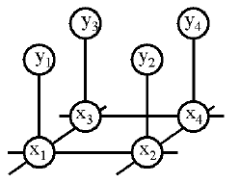
A Real Markov Net
Observed pixels
Latent causes
Estimate P(x₁, …, x_{n} | y₁, …, y_{n})
Ψ₁(x_{i}, y_{i}) = P(y_{i} | x_{i}): local evidence likelihood
Ψ₂(x_{i}, x_{j}) = exp(-J(x_{i}, x_{j})): compatibility matrix
Notes:
Next slide has example – segmentation: cause is an object ID

Slide 46
Example Of Image Segmentation With MRFs
Sziranyi et al. (2000)

Slide 47
Graphical Models Are A Useful Formalism
E.g., feedforward neural net
with noise, sigmoid belief net
Output layer
Hidden layer
Input layer

Slide 48
Graphical Models Are A Useful Formalism
E.g., Restricted Boltzmann machine (Hinton)
Also known as Harmony network (Smolensky)
Hidden units
Visible units

Slide 49
Graphical Models Are A Useful Formalism
E.g., Gaussian Mixture Model

Slide 50
Graphical Models Are A Useful Formalism
E.g., dynamical (time varying) models in which data arrives sequentially or output is produced as a sequence
Dynamic Bayes nets (DBNs) can be used to model such time-series (sequence) data
Special cases of DBNs include
Hidden Markov Models (HMMs)
State-space models

Slide 51
Hidden Markov Model (HMM)
X_{i} is a
Discrete
RV
X₁
X₂
X₃
Phones/ words
Y₁
Y₃
Y₂
acoustic signal
transition matrix
Gaussian observations

Slide 52
State-Space Model (SSM)/ Linear Dynamical System (LDS)
X_{i} is a
Continuous
RV
(Gaussian)
X₁
X₂
X₃
“True” state
Y₁
Y₃
Noisy observations
Y₂

Slide 53
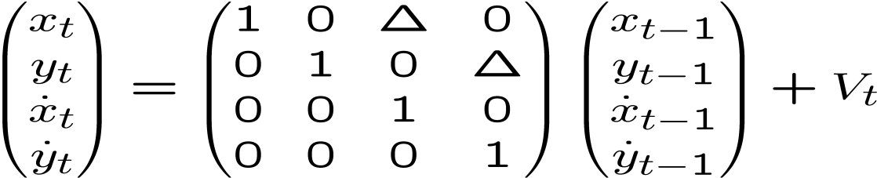
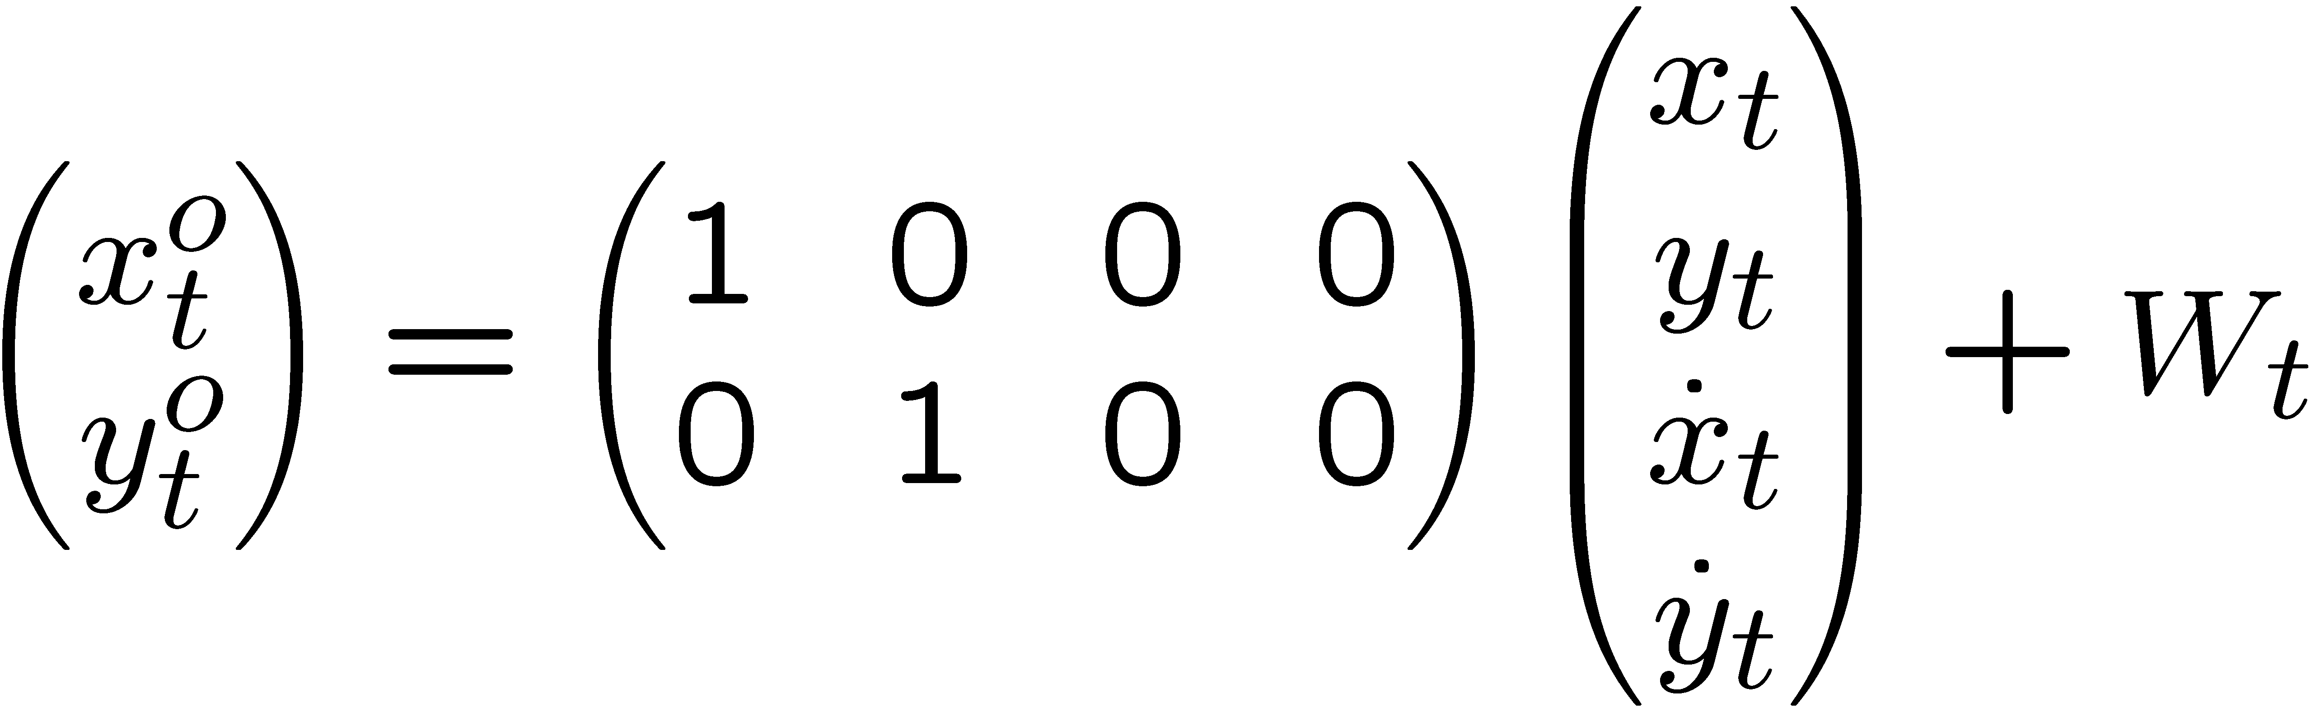
Example: LDS For 2D Tracking
sparse linear-Gaussian system
X₁
X₂
X₁
X₂
Q₁
Q₂
Q₃
y₁
y₂
y₁
y₂
R₁
R₂
R₃
o
X₁
o
X₂
o
o
y₁
y₂

Slide 54
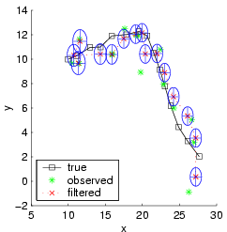
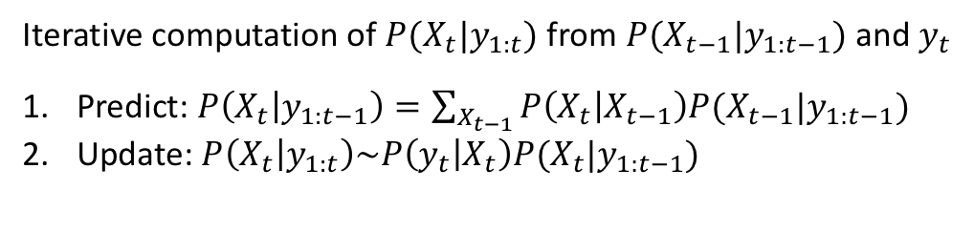
Kalman Filtering (Recursive State Estimation In An LDS)
X₁
X₂
X₃
Y₁
Y₂
Y₃
Iterative computation of $P(X_{t}|y_{1:t})$ from $P(X_{t−1}|y_{1:t−1})$ and $y_{t}$
Predict: $P\left(X_{t} | y_{1:t−1}\right)=\sum_{X_{t−1}}{P\left(X_{t} | X_{t−1}\right)P(X_{t−1}|y_{1:t−1})}$
Update: $P\left(X_{t} | y_{1:t}\right)\sim P\left(y_{t} | X_{t}\right)P(X_{t}|y_{1:t−1})$

Slide 55
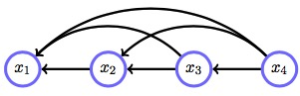
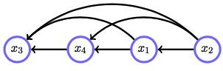
Recognize What This Graph Represents?
Notes:
Which is more general?
Both represent lack of independence

Slide 56

Notes:
Reminder – readings
Section 3.4 – CAUSALITY!!!!!! Simpson’s paradox – confusing causality (what happens when we intervene) and correlation (what happens when we observe)

Slide 57
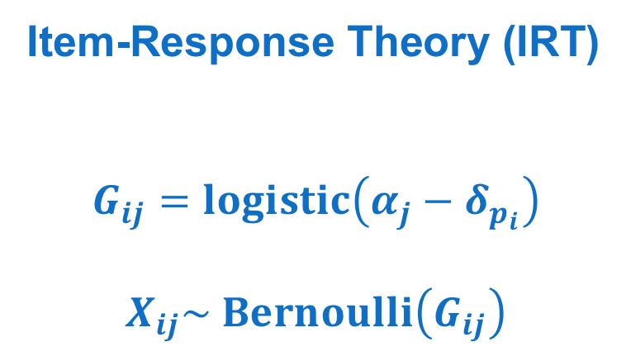
Khajah, Wing, Lindsey, & Mozer (2014)
problem
δ
Item-Response Theory (IRT)
$$G_{ij}=logistic\left(α_{j}−δ_{p_{i}}\right)$$
$$X_{ij}\sim Bernoulli\left(G_{ij}\right)$$
α
G
X
P
trial (i)
student (j)
Notes:
Explain plate notation

Slide 58
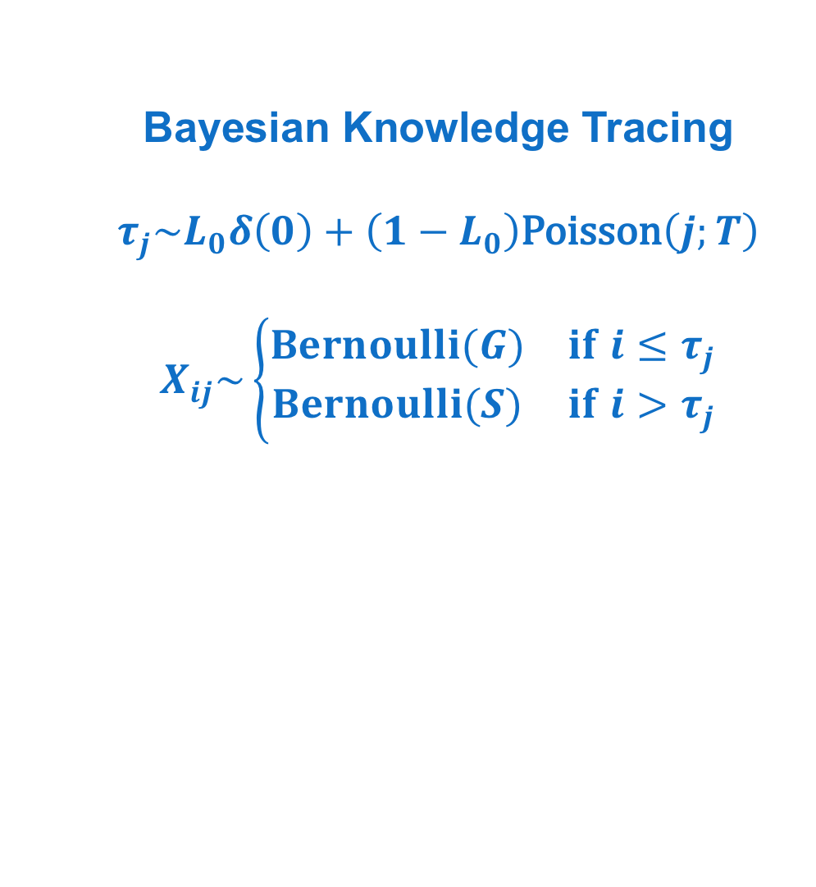
Khajah, Wing, Lindsey, & Mozer (2014)
Bayesian Knowledge Tracing
$$τ_{j}\sim L_{0}δ\left(0\right)+\left(1−L_{0}\right)\text{Poisson}\left(j;T\right)$$
$$X_{ij}\sim \left\{\begin{matrix}Bernoulli(G) & if i≤τ_{j} \\ Bernoulli(S) & if i>τ_{j}\end{matrix}\right.$$
G
S
L₀
τ
X
T
trial
student

Slide 59
Khajah, Wing, Lindsey, & Mozer (2014)
IRT+BKT model
problem
δ
γ
σ
η
α
G
S
L₀
τ
X
P
T
trial
student

